Slide 1
FDP assignment on GEN-AI AI FOR ENVIRONMENTAL IMPACT ASSESSMENT FOR SUSTAINABLE FUTURE presented By V MAHENDRA (471064) DEPARTMENT OF CIVIL ENGINEERING PACE ITS

Slide 2
Problem Statement:
AI for ENVIRONMENTAL IMPACT ASSESSMENT FOR SUSTAINABLE FUTURE
* Using Python Programming Language source code was executed and results are shown in the next slides.

Slide 3
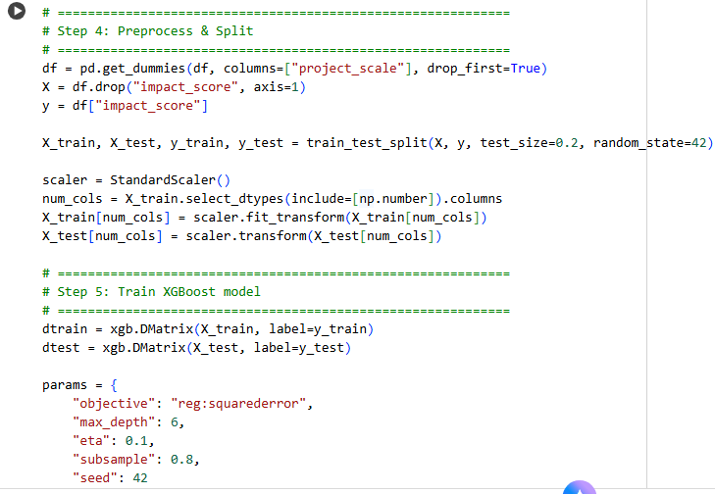
Source Code:

Slide 4
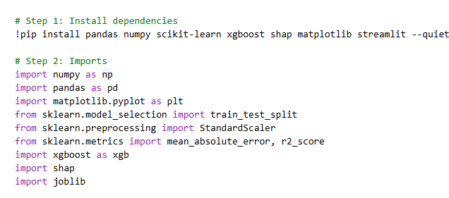

Slide 5
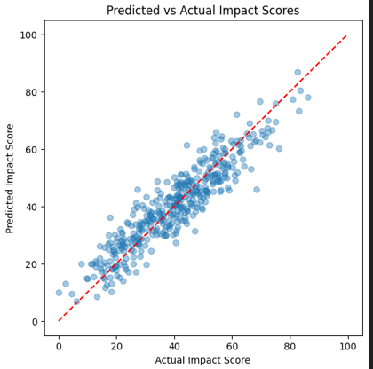
Results:
Execution Graphical Result:

Slide 6
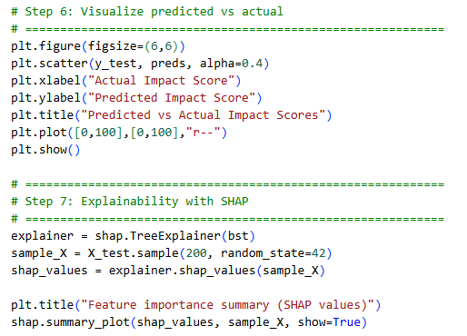
Results(Cont..)

Slide 7
